Slide 1



CARDIOVASCULAR STUDY
By GHANSHYAM SINGH SHAKTAWAT
3rd CAPSTONE PROJECT

Slide 2
INTRODUCTION
In this project, the primary objective is to develop a predictive model for identifying individuals at risk of future Coronary Heart Disease (CHD) within the next 10 years. Leveraging advanced classification techniques, the model will analyze relevant patient data to discern patterns indicative of heightened CHD risk. This undertaking is crucial for early intervention and personalized healthcare, aiming to enhance preventive strategies and contribute to a reduction in the incidence of this prevalent cardiovascular condition.
Furthermore, the project incorporates data visualization techniques to elucidate patterns and trends within the dataset. Visual representations of key features and their impact on CHD risk will enhance interpretability, fostering a comprehensive understanding and aiding in the formulation of targeted preventive measures.

Slide 3



CLASSIFICATION
Classification is a machine learning task wherein the goal is to assign predefined labels or categories to input data based on patterns and features. The algorithm learns from a labeled dataset, discerning relationships between input variables and corresponding classes. Once trained, the model can classify new, unseen data into predefined categories, making it a valuable tool for tasks like predicting outcomes, identifying patterns, and sorting information into distinct classes for decision-making purposes.

Slide 4
OBJECTIVE
The objective of this project is to develop an accurate predictive model for assessing the 10-year risk of Coronary Heart Disease (CHD) in individuals. Leveraging advanced classification algorithms and data visualization techniques, the project aims to analyze diverse patient data, identify key risk factors, and create an interpretable model. The goal is to provide healthcare professionals with a reliable tool for early detection, enabling timely intervention and personalized preventive strategies. Ultimately, the project aspires to contribute to the mitigation of CHD incidence, promoting proactive healthcare and improving patient outcomes.

Slide 5
FRAMEWORK
DATA WRANGLING
VISUALISATION
Total Patient Count
Maximum/Minimum age
Male-Female Count
Average Chol per age
Avg count of smoke as per age
Avg heartrate as per age
Avg blood pressure as per age
Avg risk factor
Cholesterol VS Sex
Risk of CHD VS Age
Smoking VS Gender
SysBP VS Age
BMI VS Age
Age Count
Glucose VS Age
Cigs per day VS Age

Slide 6
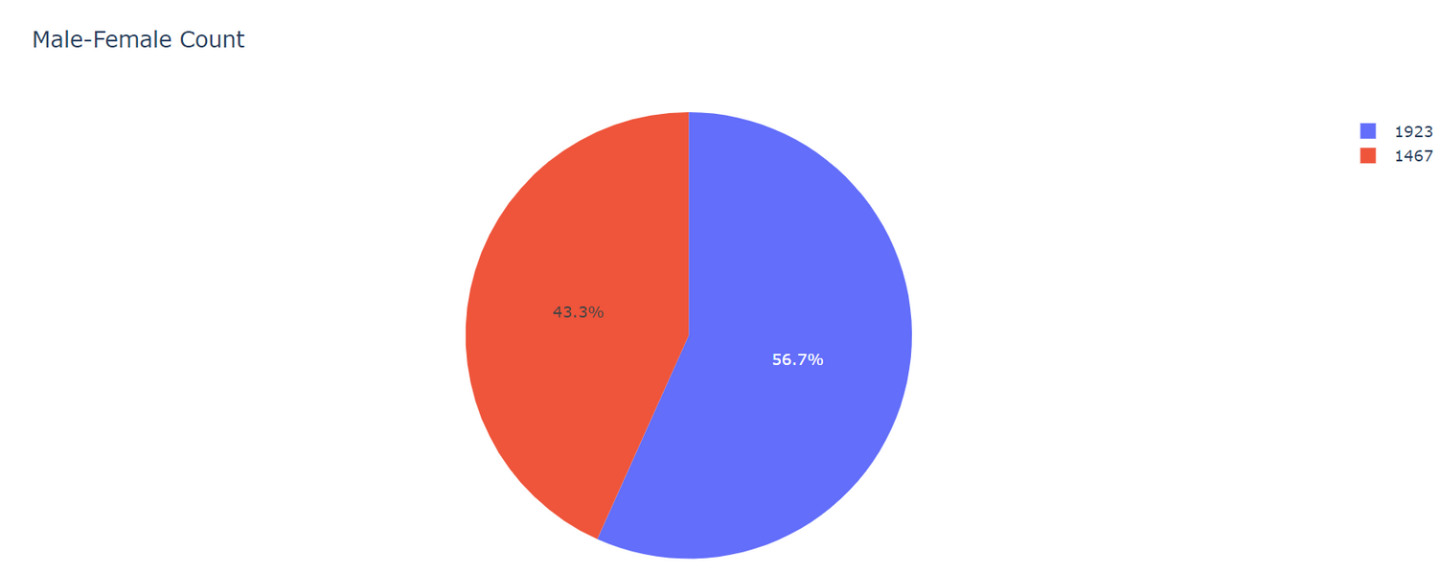
MEN-WOMEN COUNT
Out of total entries i.e. 3390, the 43.3% of population is female, which counts as 1467. However, the other 56.7% of population is male, which is 1923. The shaded region in red is female and the blue region is male.
ANALYSIS

Slide 7
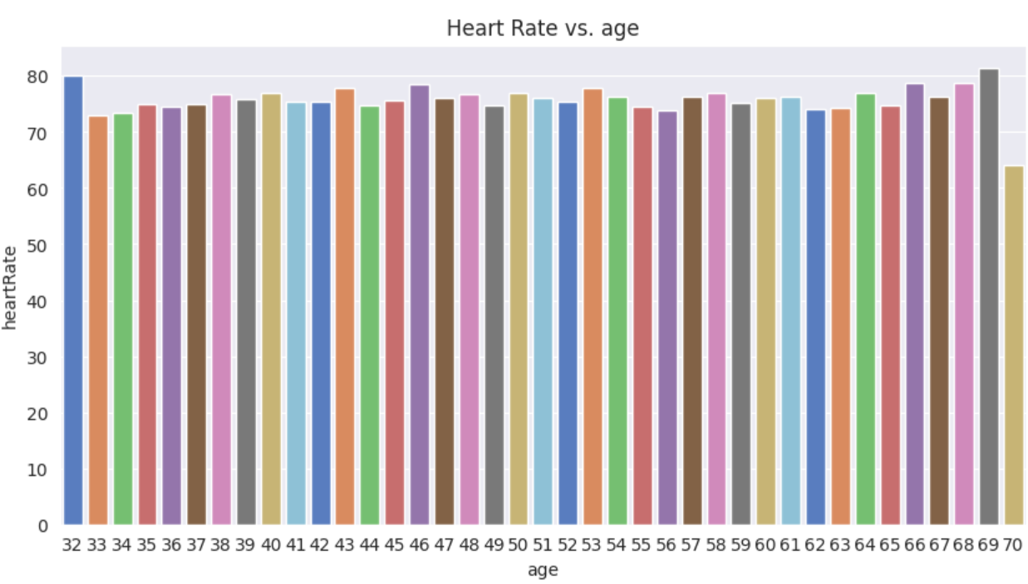
HEART-RATE VS AGE
The above chart shows that the heart rate for the population of age 32 is 80. However, later on the heart rates are almost constant, i.e., very gradually increasing. The heart rate is extremely high at 69; i.e. above 80.

Slide 8
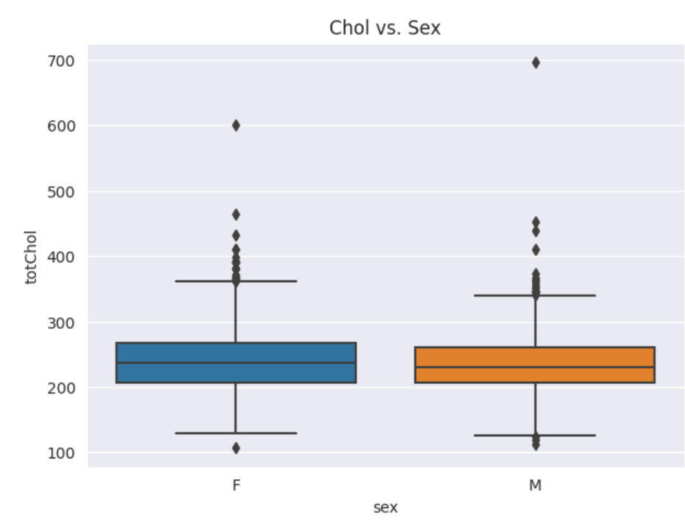
CHOL VS SEX
This graph indicates the clear range of cholesterol levels in the total population. The range varies from 200-250. Although the distribution looks almost same at first glance, on a closer look, female population has a slightly higher culmination of cholesterol.

Slide 9
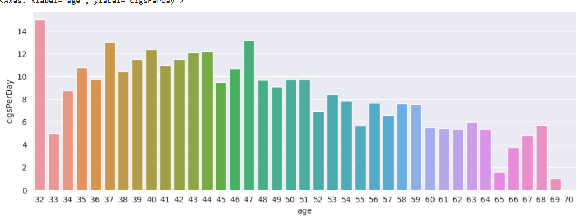
CIGS VS AGE
The bars represent various ages of the population and their average number of cigarettes consumption per day. It is notable, that the highest number of cigarettes are consumed by the people of age 32. Though the trends show decline in the numbers, the population at age 47 shows sudden hike while the population at age 65 is smoking least in the total population.

Slide 10
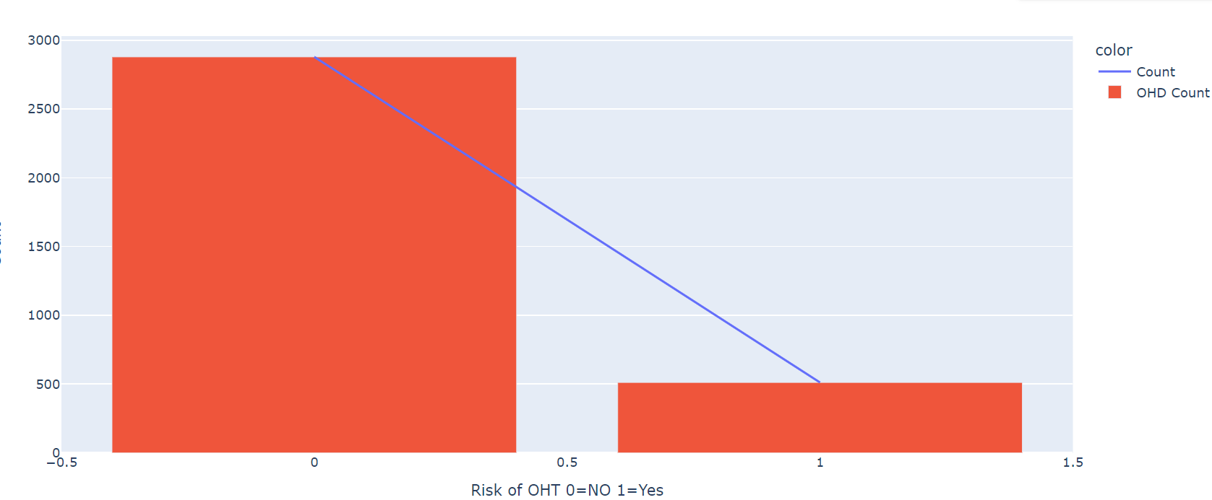
RISK OF CHD
The key conclusions withdrawn from this chart includes number of people having CHD disease from last 10 years i.e. 2879 and about 511 people do not have CHD disease. The numbers are alarming as it simplifies the analysis by showing clearly a large count of people already going through this disease from last 10 years. On an average 85%+ people are currently facing this disease actively in the area.

Slide 11
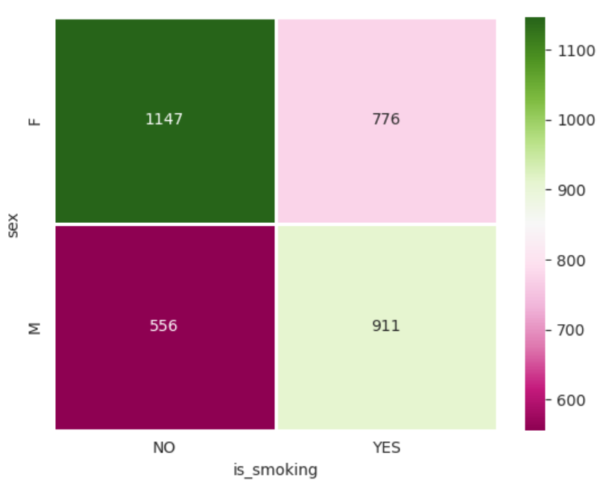
SMOKING VS GENDER
This heatmap is used to represent complex relationship and patterns by using color gradients to indicate values. It is effective in showing gender-based classification and if they smoke cigarettes or not. It is an intuitive and visually appealing way to discover insights and trends within the dataset. This map shows a clear representation of exponentially high number of men smoking cigarettes i.e. 911. However, there’s a good number of male population that stays away from cigarettes; i.e. 556. In case of women, around 776 women appear to be smoking cigarettes while, 1147 don’t smoke at all.

Slide 12
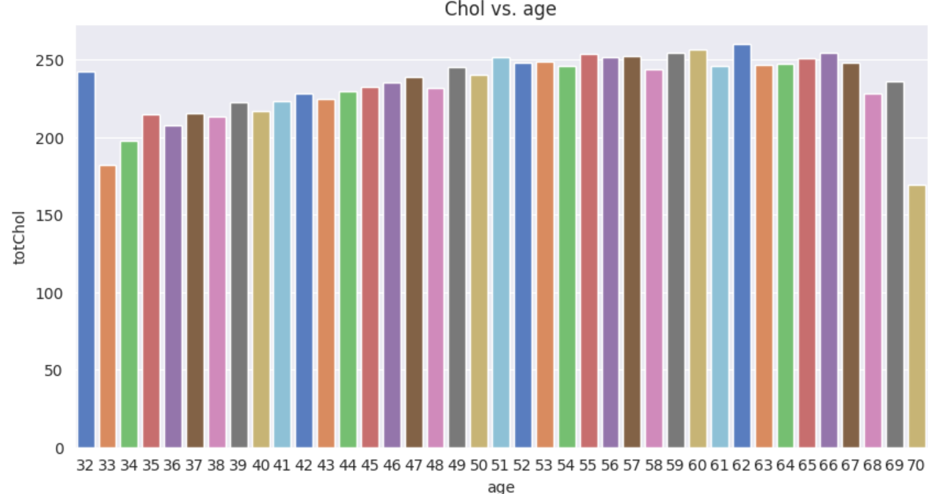
CHOL VS AGE
As the plot suggests, the cholesterol levels are evidently high at the age of 32. However, a relatively less levels is found afterwards. The trends show growth with the increasing age. The highest cholesterol levels are found at the age of 62.

Slide 13
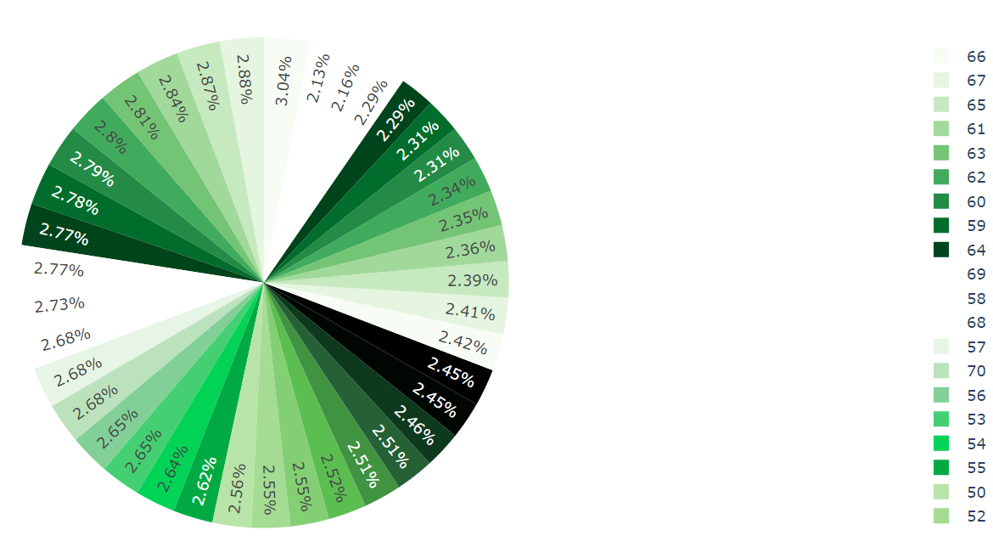
SYSBP VS AGE
This pie-chart shows division of Sys BP in various age groups, representing the proportionality of different categories within the ages. It shows relative importance of individual components and emphasizing their contribution to overall composition.
This chart shows the data collected from the population is from the age of 32 years. Although there’s a gradual increase in the levels until the age of 55. After 55, the BP is mostly high in all. At 66, it is the highest with the levels at 158.

Slide 14
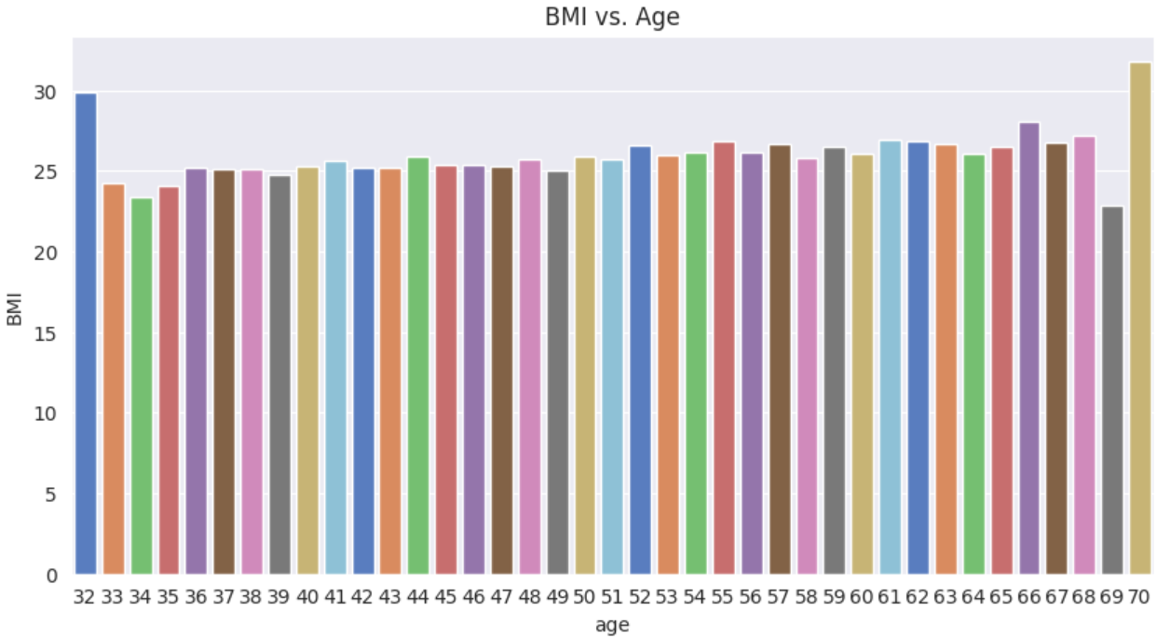
BMI VS AGE
The plot shows the youngest population of the dataset has a strong Body mass Index (BMI) of 30 for 32. The BMI in all of the dataset is somewhat constant with minor variations in the middle ages. The BMI is exceptionally high at the age of 70, which is above 30, making it highest of all.

Slide 15
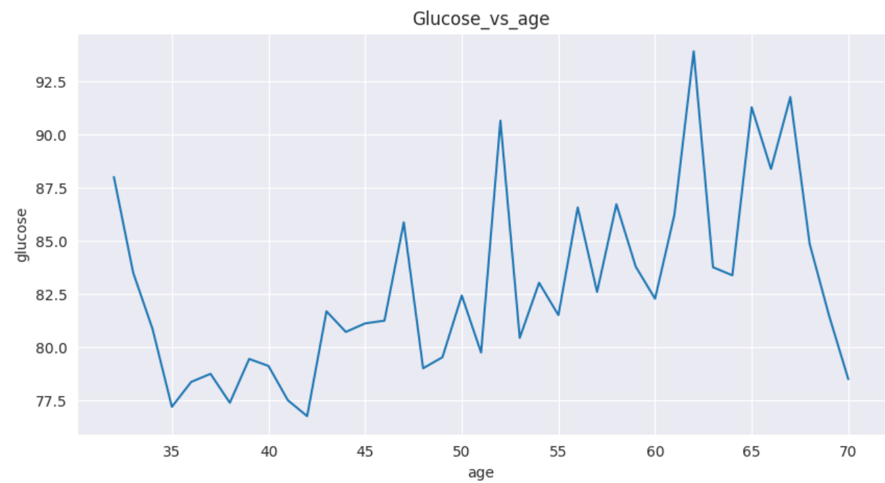
GLUCOSE VS AGE
This line graph shows that the glucose levels are high until the age of 35. Though it gets constant and controlled till 40. They are again at rise until 60. It is important to notice that between 60-65 they are at an all time high which is around 92.

Slide 16
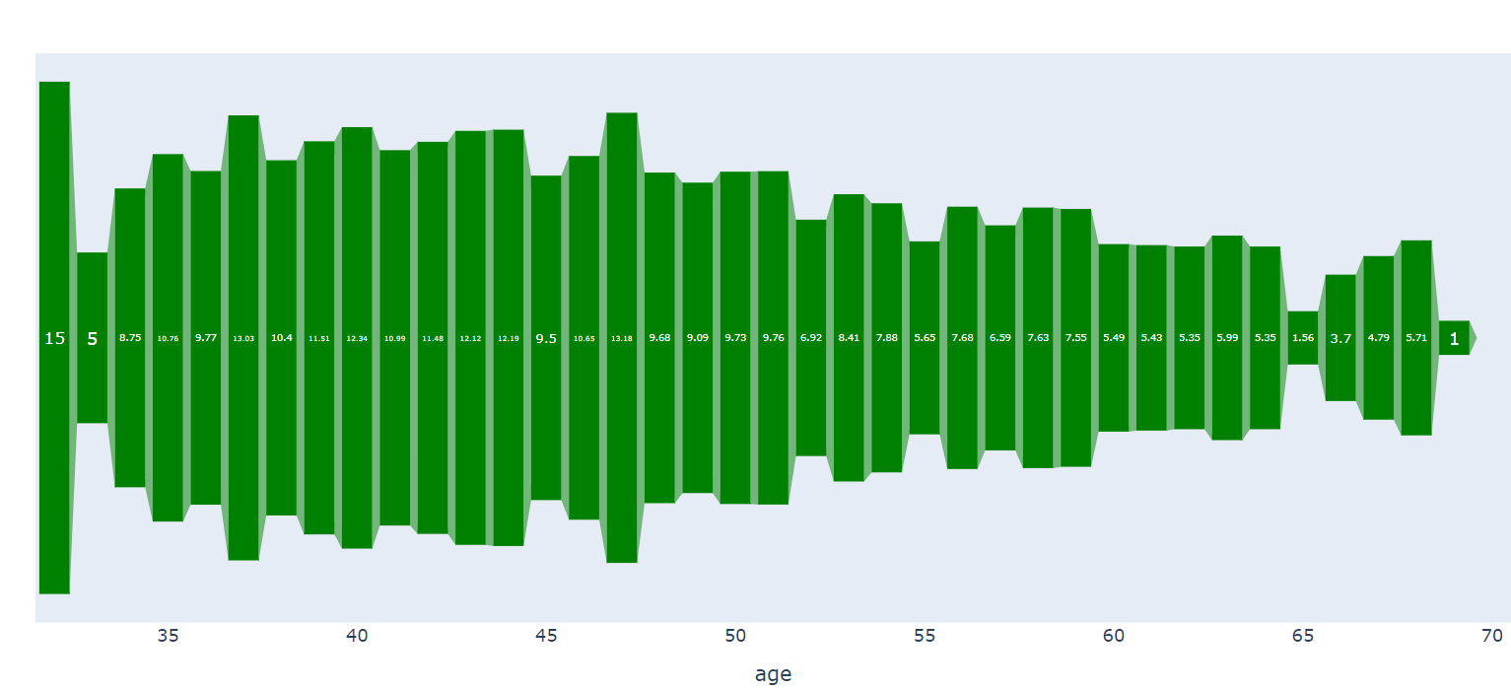
AGE VS CIGS PER DAY
This chart shows that the youngest of the population is actually the highest smoking people out of whole population. The total number of cigarettes consumed by them is 15. However, the lowest can be seen at the age of 69 which is only 1. The similar but slightly higher consumption can be seen at the age of 65.

Slide 17
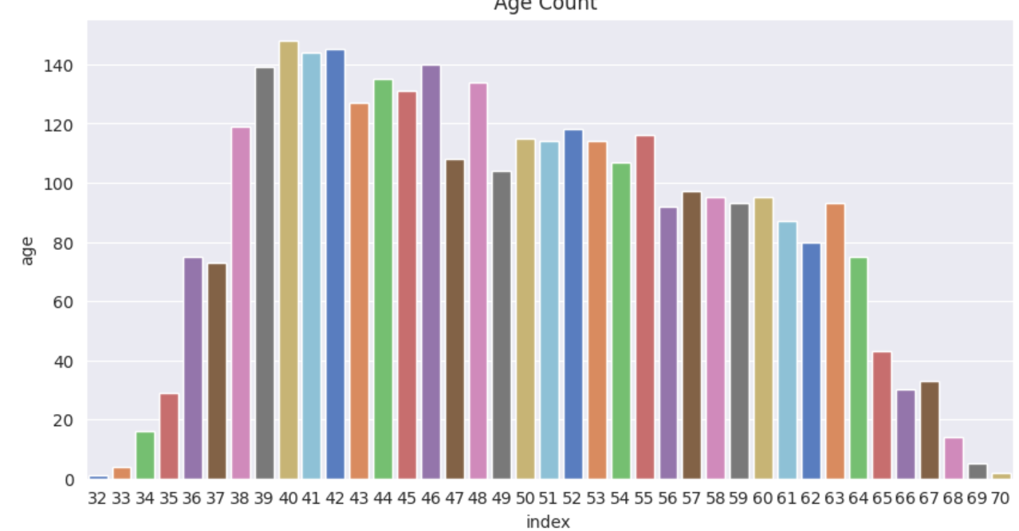
AGE COUNT
This graph is showing the unique age count of total population. It can be seen that the highest number of people i.e. 140 comes under the age of 40. However, lowest is age 30 with only 1 person and later followed by 70 which has 5

Slide 18
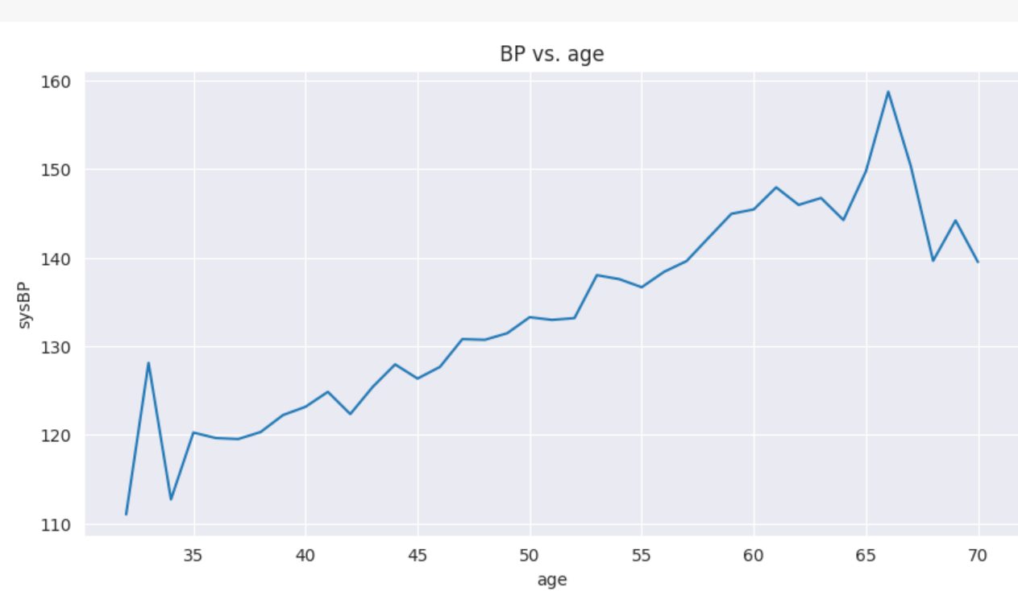
BP VS AGE
A line graph is a suitable option for depicting age vs. blood pressure (BP) as it effectively displays trends and changes over a continuous variable (age). The continuous line facilitates the observation of patterns, variations, or correlations in BP across different age points. This visualization method is especially useful for illustrating how BP levels may change gradually with age, providing a clear and informative representation of the relationship. This graph helps in concluding that Sys BP is directly proportional to age, which means Sys BP is increasing with age increasing. Also, there is a sudden hike after the age of 60.

Slide 19
CONCLUSION
1. Total Entries = 3390
2. Male = 1467
3. Female= 1923
4. Total age range = 32-70
5. Non-Smoker Females = 1147
6. Smoker Females = 776
7. Non-Smoker Males = 556
8. Smoker Males = 911
9. People with no risk of 10 years = 511
10. People with risk of 10 years = 2879

Slide 20
CONCLUSION
32 age group people consume 15 cigarettes per day.
70 age group people consume 0 cigarettes per day.
62 age group people have an average of 260 cholesterol measure, which is high among all age groups.
70 year old people have an average of 169 cholesterol measures, which is low among all age groups.
Heart rate is higher for age group 32 and 69 which is nearly equal to 80.
The lowest heart rate was recorded for age 70 which is 64.

Slide 21
THANK YOU !
by Ghanshyam Singh Shaktawat

